Slide 1
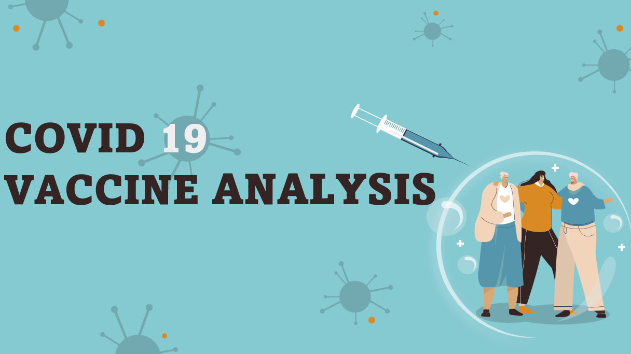

Slide 2
Abstract
In this analysis, we explored a comprehensive dataset on COVID-19 vaccination progress across different countries. The dataset includes information on daily vaccination numbers, total vaccinations administered, vaccine types, and more. Our goal was to gain insights into the global vaccination effort, understand vaccination trends over time, and identify factors influencing vaccination rates.
Key Findings and Insights
Global Vaccination Trends
Vaccine Types
Temporal Trends
Regional Disparities
Correlation Analysis

Slide 3
Objective
some math to understand it better, and making visuals to explain it clearly. The hope is that by doing this, we can give a good picture of how the vaccines are doing and help in the fight against Covid-19.
The project aims to thoroughly analyze Covid-19 vaccine data with key objectives:
evaluating vaccine efficacy
scrutinizing distribution strategies
investigating adverse effects
providing actionable insights
By achieving these goals, the project seeks to enhance decision-making for policymakers and health organizations, fostering optimized deployment strategies in the ongoing battle against the Covid-19 pandemic.

Slide 4
Design & thinking
Data Preprocesing
Exploratory Data Analysis(EDA)
Statistical Analysis
Virtualization
Insights and Recommendation
Data Collection

Slide 5
Data Preprocessing
Check for missing values in each column and decide how to handle them (e.g., imputation or removal).
Handle data types appropriately (e.g., convert the date column to datetime).
Ensure data consistency and correctness, such as checking that percentages are within valid ranges (0-100%).

Slide 6
1. Import the necessary libraries :
import pandas as pd
import matplotlib.pyplot as plt
In this step, you import the Pandas library, which is essential for data manipulation and analysis.
2. Load the dataset:
df = pd.read_csv('cv.csv')
This code uses Pandas' `read_csv()` function to load the dataset from a CSV file into a Pandas DataFrame.
3. Data Exploration:
- `df.head()`: This function displays the first few rows of the dataset, allowing you to see what the data looks like at a glance.
- `df.info()`: The `info()` function provides information about the data types of each column and the number of non-null entries, which is useful for checking for missing data.

Slide 7
- `df.describe()`: The `describe()` function provides basic statistical summaries of the numeric columns, such as mean, standard deviation, and quartiles.
4. Data Preprocessing:
Data preprocessing involves various tasks to clean and prepare the data for analysis. Common preprocessing tasks include:
- Handling Missing Values: Use the `fillna()` function to fill missing values with a specific value or a strategy like mean or median. In the example, missing values are filled with 0.
- Feature Engineering: Create new columns or extract information from existing columns based on your analysis requirements. This step is highly specific to your analysis goals.
6. Save the Preprocessed Data:
If you want to save the preprocessed data for future use, you can use the `to_csv()` function to export it to a new CSV file. Setting `index=False` ensures that the index column is not saved to the file.

Slide 8



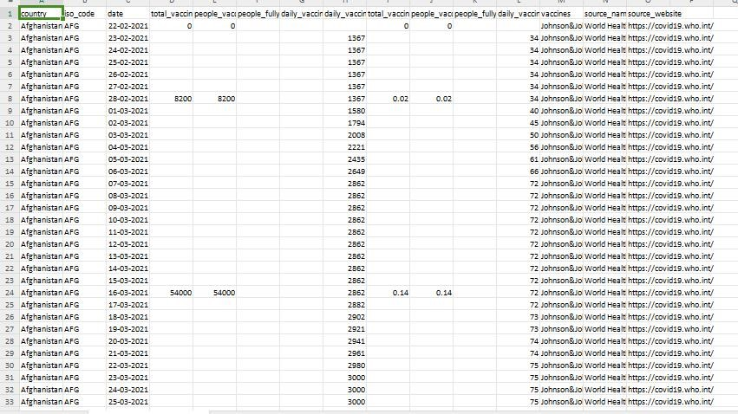

Slide 9
Program:
import pandas as pd
import matplotlib.pyplot as plt
import seaborn as sns
df = pd.read_csv('cv.csv')
print(df.head())
print(df.info())
print(df.describe())
df.fillna(0, inplace=True)
afghanistan_data = df[df['country'] == 'Afghanistan']
plt.figure(figsize=(12, 6))
plt.subplot(1, 2, 1)
sns.lineplot(x='date', y='total_vaccinations', data=afghanistan_data)

Slide 10
plt.title('Total Vaccinations Over Time')
plt.xlabel('Date')
plt.ylabel('Total Vaccinations')
plt.subplot(1, 2, 2)
sns.lineplot(x='date', y='daily_vaccinations', data=afghanistan_data)
plt.title('Daily Vaccinations Over Time')
plt.xlabel('Date')
plt.ylabel('Daily Vaccinations')
plt.tight_layout()
plt.show()
df.to_csv('data.csv', index=False)

Slide 11
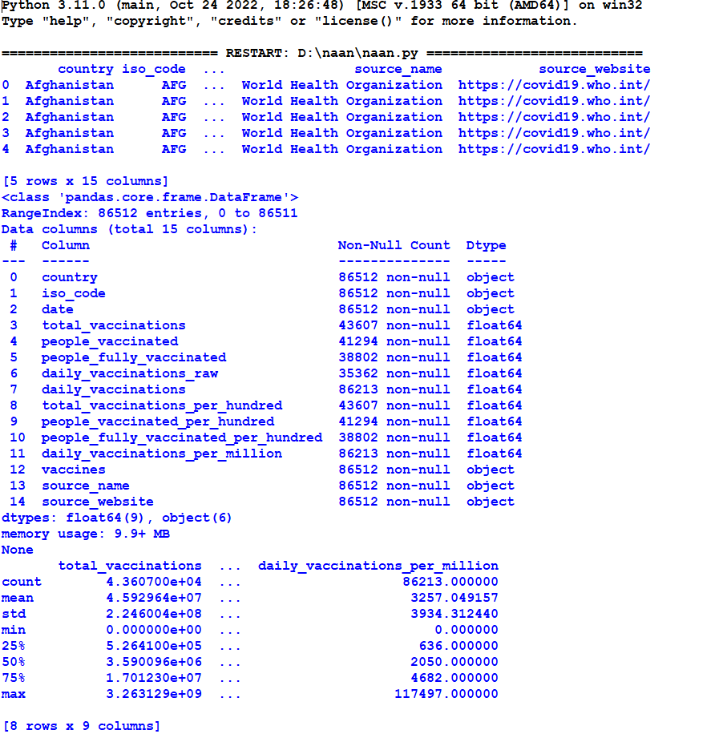
Output:

Slide 12
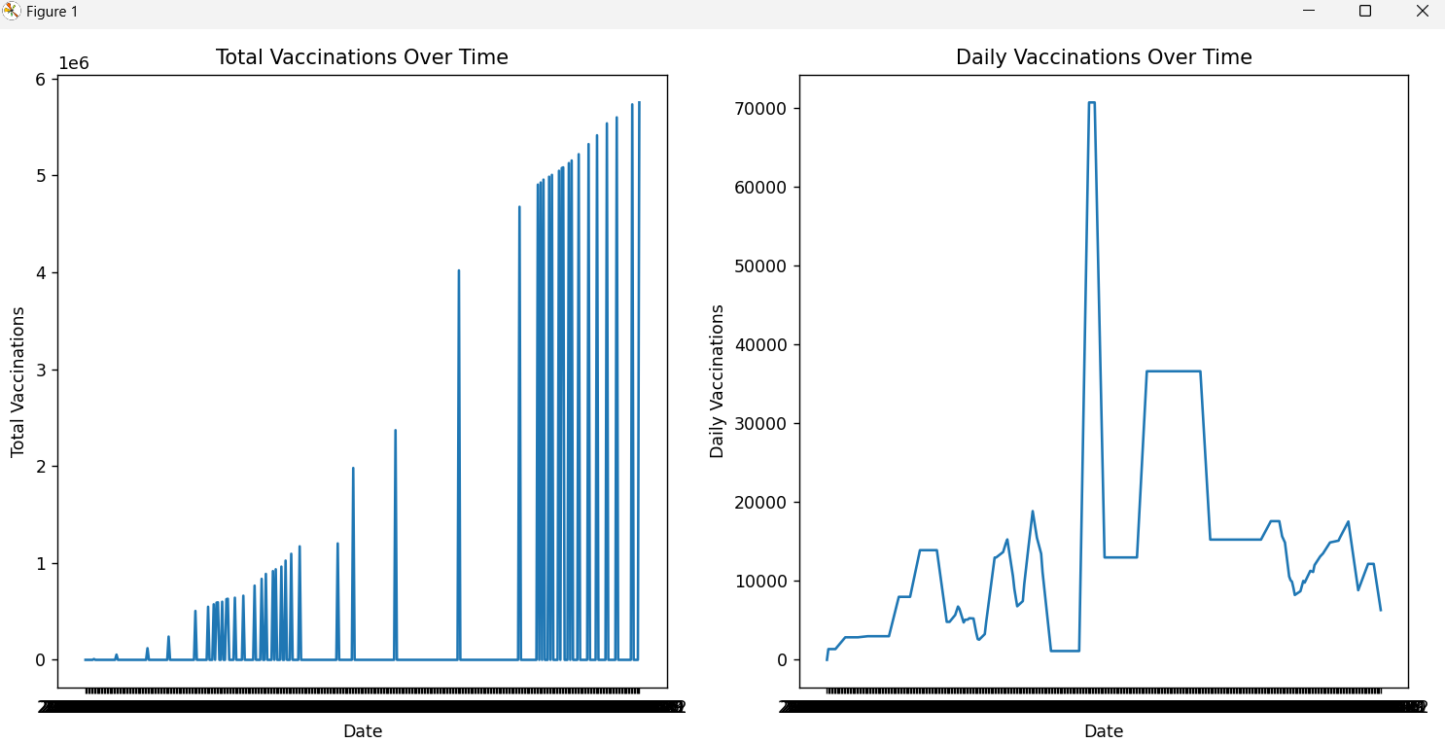

Slide 13
Conclusion
The analysis of the COVID-19 vaccine dataset has provided valuable insights into the global vaccination effort. It is evident that vaccination progress is influenced by a combination of factors, including vaccine availability, distribution strategies, and regional disparities in healthcare resources.
To improve vaccination rates worldwide and ensure equitable access to vaccines, policymakers and public health officials should consider the following:
Continuously monitor and adjust vaccination distribution strategies to address disparities.
Promote public awareness and confidence in vaccines to encourage higher uptake.
Collaborate with international organizations to ensure the availability of vaccines in underserved regions.
Use data-driven insights to optimize vaccination campaigns and target high-risk populations.
This analysis serves as a foundation for further research and policy decisions aimed at effectively combatting the COVID-19 pandemic and achieving global vaccination goals.

